Slide 1
Promises in JS

Slide 2
Why We Use Promise?
In JavaScript code is executed synchronously that is in sequential order.
Synchronous means the code is executed one by one like one line is executed then the next line is executed and so on.
This means each statement has to wait for the previous statement to finish executing.
Asynchronous operation in JavaScript breakup long operation into shorter ones so other operations can execute.
Asynchronous delayed execution by postponing the heavy operation to the end of the event loop, to give event handlers the ability to respond.
Asynchronous code takes statements outside of the main program flow, allowing the code to run without blocking and waiting for the result or other to finish.

Slide 3
What is Promise?
Promise is a good way to handle asynchronous operations
It is used to find out if the asynchronous operation is successfully completed or not.
A promise may have one of three states
Pending – process is not complete
Fulfilled – operation successful
Rejected – an error occurs

Slide 4
Promise
In JavaScript promise is the same as a promise we make in real life. When we make a promise in real life, it is assured that we are going to do keep in the future. As promises can only be made for the future.
A promise has 2 general outputs: it will either be kept when the time comes, or it won’t.
Suppose you are appearing for the exam; your dad promises you to give the new bike after getting a pass with first class. That is Promise, A promise has 3 stated
Pending: You don’t know if you will get the bike
Fulfilled: Dad is happy with your first class and he will give you the new bike
Rejected: Dad is not happy as you didn’t get the first class, he withholds the new bike

Slide 5
Where to use Promises
When we are using API and want to make an asynchronous call to remote web services and requesting some data from web service then the JavaScript promise promises us to get data from web services and we can use it in the future.
It is used for handling asynchronous events and It’s mostly used for handling the asynchronous HTTP requests

Slide 6
Promises features
It’s good for handling asynchronous operation
Good for handling multiple asynchronous operations
Provide better error handling
It improves the code readability

Slide 7
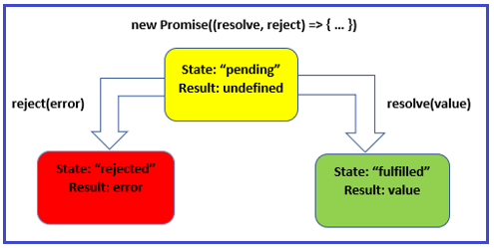
The JavaScript Promises States and Control flow

Slide 8
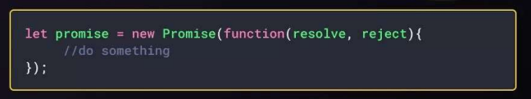
Create A Promise
To Create a promise object, we use the Promise() constructor
If the promise returns successfully, the resolve() function is called.
If an error occurs, the reject() function is called.

Slide 9
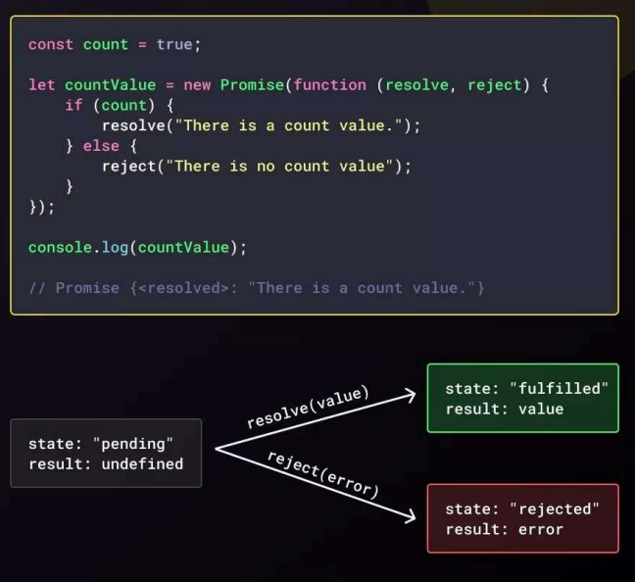

Slide 10
JavaScript Promise Control flow
A promise is said to be settled or resolved when it is either fulfilled or rejected.
Once a promise is settled, it becomes immutable, and its state cannot change.
The then() and catch() methods of a promise can be used to attach callbacks that execute when it is settled.
These callbacks are called with the fulfillment value and rejection reason, respectively.

Slide 11
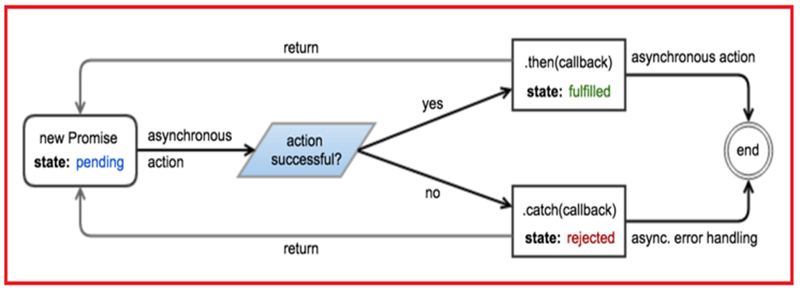

Slide 12
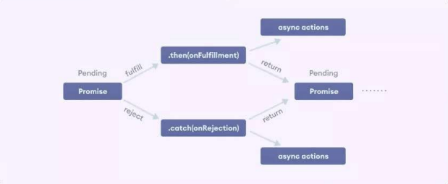
Promise Chaining
Promises are useful when you have to handle more than one asynchronous task, one after another. For that we use promise chaining.
To perform an operation after a promise resolved using methods then(), catch(), and finally()

Slide 13
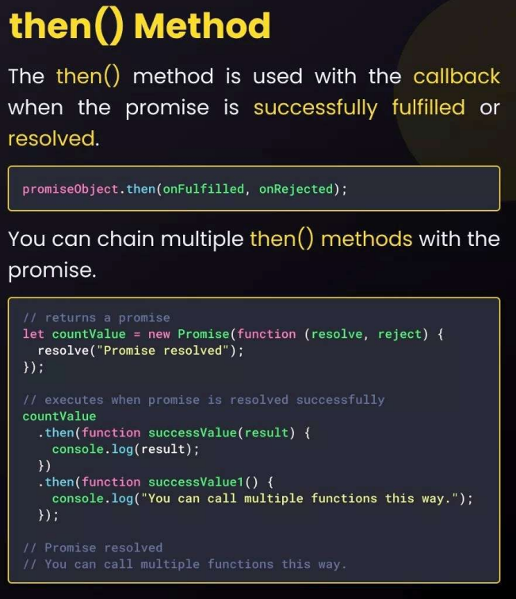
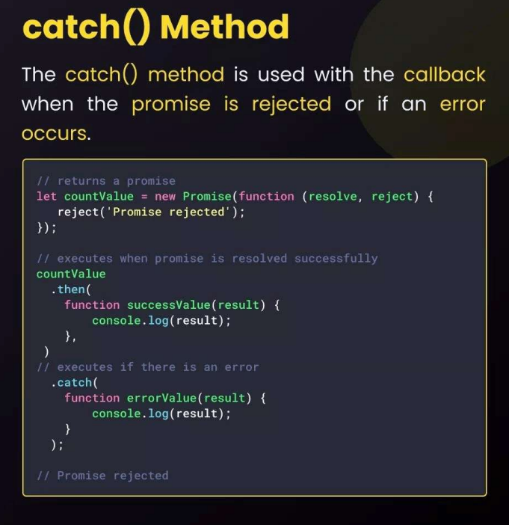

Slide 14
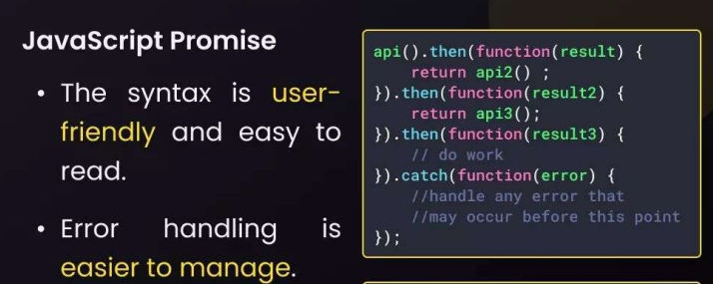
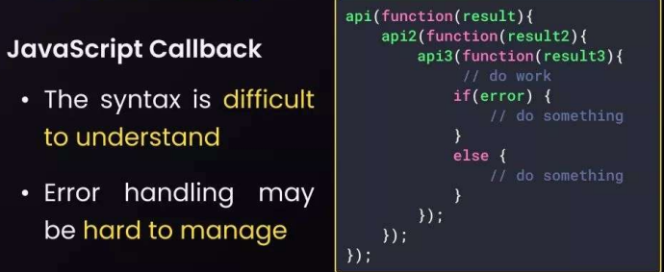
Promises VS Callback

Slide 15
Task
Fetch data from this : dummyjson.com/carts and Design a Cart Page using bootstrap.

